Slide 1

JavaScript Advanced
Course Overview
SoftUni Team
Technical Trainers
Software University
http://softuni.bg

Slide 2
Table of Content
Introduction
Training & Team
Course Objectives
Course Organization

Slide 3
Have a Question?
sli.do
#JS-CORE

Slide 4













SoftUni Diamond Partners

Slide 5




SoftUni Organizational Partners

Slide 6

JS Advanced
Course Introduction

Slide 7
What are we going to learn?
In this course we are going to learn:
Advanced Functions: IIFE, this, call, apply, bind
Unit Testing with Mocha
Classes and Members
Object Composition and Revealing Modules
jQuery and Advanced DOM manipulations

Slide 8

Trainers and Team

Slide 9
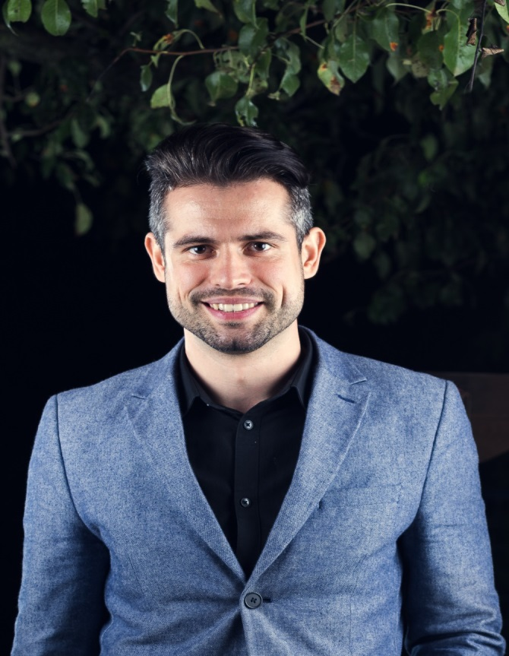
Ivaylo Papazov
Full-Stack Developer in SoftUni
Technical Trainer in SoftUni
Experience in JS, C#, Node.js, React, ASP.NET MVC
TelerikAcademy Graduate

Slide 10
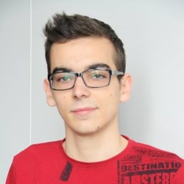
Kiril Kirilov
Techinal Trainer @ Software University
Involved with programming since high school
Passionate about .NET, JavaScript, Angular
Currently studying Math & Informatics at Sofia University (FMI)

Slide 11

Behind the Scenes
The team:
Antonia Atanasova
Bilyana Borislavova
Hristomir Asenov
Karina Cholakova
Kiril Kirilov
Tanya Staneva

Slide 12

Course Objectives
Course Details and Schedule

Slide 13
Targets of the Course
Advanced coding skills for the JS language
Extends the JS Fundamentals course
Covers: DOM, Advanced Functions, IIFE, Object Composition, Unit Testing, Classes and Inheritance, Modules, Transpilers, Exceptions, Generators, Iterators

Slide 14
Exam
Link to last JS-Advanced exam: https://judge.softuni.bg/Contests/1390/JS-Advanced-Exam-19-December-2018
Structure: 4 problems for 6 hours
Problem One – Dom manipulations
Problem Two – Unit testing
Problem Three – Classes
Problem Four – Advanced jQuery/DOM using Classes

Slide 15

Course Organization

Slide 16

Structure of the course
Lectures:
Twice a week (4 hours each)
Learn new material
Exercises:
Twice a week (4 hours each)
Practice learned material
Ask questions if any

Slide 17

Evaluation Criteria
Mandatory:
Final exam – 85%
Exercises & homework – 15%
Bonuses:
Presence in class – 5% bonus
Forum activity – bonus up to 5%

Slide 18
https://softuni.bg/courses/javascript-advanced

Slide 19




Trainings @ Software University (SoftUni)
Software University – High-Quality Education and Employment Opportunities
softuni.bg
Software University Foundation
http://softuni.foundation/
Software University @ Facebook
facebook.com/SoftwareUniversity
Software University Forums
forum.softuni.bg

Slide 20

License
This course (slides, examples, demos, videos, homework, etc.) is licensed under the "Creative Commons Attribution-NonCommercial-ShareAlike 4.0 International" license

